Slide 1
Decompose R[ABCD] into BCNF with FDs:
FD1: AB→C
FD2: AB→D
FD3: C→A
FD4: D→B
BCNF Rule: Left Side of all FDs must be a superkey.
R[ABCD]

Slide 2
Decompose R[ABCD] into BCNF with FDs:
FD1: AB→C
FD2: AB→D
FD3: C→A
FD4: D→B
BCNF Rule: Left Side of all FDs must be a superkey.
C is not a superkey, so decompose R based on C→A Note we “lose” FD1 and FD2 because the attributes aren’t in the same table anymore
R[ABCD]
R2[CA]
R1[BCD]

Slide 3
Decompose R[ABCD] into BCNF with FDs:
FD1: AB→C
FD2: AB→D
FD3: C→A
FD4: D→B
BCNF Rule: Left Side of all FDs must be a superkey.
C is not a superkey, so decompose R based on C→A Note we “lose” FD1 and FD2 because the attributes aren’t in the same table anymore
D is not a superkey, so decompose R1 based on D→B
Final answer: R2, R3, R4 is in BCNF
R[ABCD]
R2[CA]
R1[BCD]
R3[DB]
R4[CD]

Slide 4
Decompose R[ABCD] into 3NF with FDs:
FD1: AB→C
FD2: AB→D
FD3: C→A
FD4: D→B
FDs are already in minimal cover

Slide 5
Decompose R[ABCD] into 3NF with FDs:
FD1: AB→C
FD2: AB→D
FD3: C→A
FD4: D→B
FDs are already in minimal cover
3NF Rule: Left Side of all FDs must be a superkey, OR Right side must be prime
Prime attribute: An attribute in ANY candidate key

Slide 6
Decompose R[ABCD] into 3NF with FDs:
FD1: AB→C
FD2: AB→D
FD3: C→A
FD4: D→B
FDs are already in minimal cover
3NF Rule: Left Side of all FDs must be a superkey, OR Right side must be prime
Candidate Keys: AB, BC, AD
Prime attributes: A, B, C ,D
All attributes are prime. All right sides are prime. R is already in 3NF
Prime attribute: An attribute in ANY candidate key

Slide 7
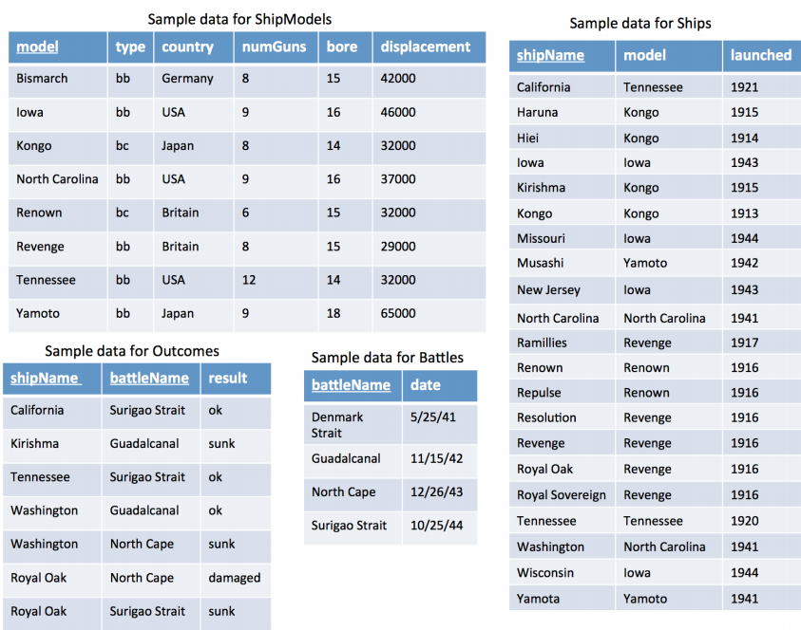
SQL

Slide 8
Find those countries that have models with both less than 7 and greater than 7 guns.
We are not allowed to use a subquery for this question
You will need to use the ShipModels table twice.

Slide 9
Find those countries that have models with both less than 7 and greater than 7 guns.
We are not allowed to use a subquery for this question
You will need to use the ShipModels table twice.
SELECT DISTINCT Country --- Country is not PK so it can be duplicated
FROM ShipModels S1, ShipModels S2 --- S1 will be for <7, S2 for >7
WHERE S1.Country = S2.Country --- Join the tables together on compare att.

Slide 10
Find those countries that have models with both less than 7 and greater than 7 guns.
We are not allowed to use a subquery for this question
You will need to use the ShipModels table twice.
SELECT DISTINCT Country --- Country is not PK so it can be duplicated
FROM ShipModels S1, ShipModels S2 --- S1 will be for <7, S2 for >7
WHERE S1.Country = S2.Country --- Join the tables together on compare att.
AND S1.numGuns<7
AND S2.numGuns>7
Result:
Country
Britain

Slide 11
Find the number of ships that participated in each battle
We want to COUNT the number of ships in EACH battle.
When we see that we apply an operation once per group we use a GROUP BY statement .
Here we will have GROUP BY battleName

Slide 12
Find the number of ships that participated in each battle
We want to COUNT the number of ships in EACH battle.
When we see that we apply an operation once per group we use a GROUP BY statement .
Here we will have GROUP BY battleName
SELECT battleName, COUNT(*)
FROM Outcomes
GROUP BY battleName

Slide 13
Find the number of ships that participated in each battle
We want to COUNT the number of ships in EACH battle.
When we see that we apply an operation once per group we use a GROUP BY statement .
Here we will have GROUP BY battleName
SELECT battleName, COUNT(*)
FROM Outcomes
GROUP BY battleName
Result:
battleName | COUNT(*)
Guadalcanal | 2
North Cape | 2
Suriago Strait | 3

Slide 14
Find the name of the heaviest ship model(s)
LIMIT is not allowed with these queries.
Split this question into 2 parts
Find the heaviest weight (largest displacement)
Find the models with that weight.

Slide 15
Find the name of the heaviest ship model(s)
LIMIT is not allowed with these queries.
Split this question into 2 parts
Find the heaviest weight (largest displacement)
Find the models with that weight.
Part 1:
SELECT MAX(displacement)
FROM ShipModels
Part 2:
SELECT model
FROM ShipModels
WHERE displacement = PART1

Slide 16
Find the name of the heaviest ship model(s)
LIMIT is not allowed with these queries.
SELECT model
FROM ShipModels
WHERE displacement = (SELECT MAX(displacement)
FROM ShipModels)
We can use = here because we KNOW the subquery will return 1 number only.
Result:
model
Yamoto

Slide 17
Find countries with at least 2 ship models, where one of the models has more guns than the average number of guns across all of the ship models.
Split this into a few parts:
What countries have more than 2 models
Is the max number of guns greater than the average?

Slide 18
Find countries with at least 2 ship models, where one of the models has more guns than the average number of guns across all of the ship models.
Split this into a few parts:
What countries have more than 2 models
Is the max number of guns greater than the average?
Part 1
SELECT country
FROM ShipModels
GROUP BY country
HAVING COUNT(*) >= 2
PART 2
Part1 AND MAX(numGuns) > (SELECT AVG(numGUNS)
FROM ShipModels)

Slide 19
Find countries with at least 2 ship models, where one of the models has more guns than the average number of guns across all of the ship models.
SELECT country
FROM ShipModels
GROUP BY country
HAVING COUNT(*) >= 2
AND MAX(numGuns) > (SELECT AVG(numGuns)
FROM ShipModels)

Slide 20
Find countries with at least 2 ship models, where one of the models has more guns than the average number of guns across all of the ship models.
SELECT country
FROM ShipModels
GROUP BY country
HAVING COUNT(*) >= 2
AND MAX(numGuns) > (SELECT AVG(numGuns)
FROM ShipModels)
Result:
country
Japan
USA

Slide 21
Find the models of ships where exactly two fought in the same battle, or there are at least three different ships of that model.
Split this into 3 parts
Find models where exactly 2 fought in the same battle
Find models where there are at least three different ships
Find models in part 1 OR part 2

Slide 22
Find the models of ships where exactly two fought in the same battle, or there are at least three different ships of that model.
Split this into 3 parts
Find models where exactly 2 fought in the same battle
Find models where there are at least three different ships
Find models in part 1 OR part 2
Part 1
SELECT model
FROM Outcomes O, Ships S
WHERE O.shipName = S.shipName
GROUP BY model, battleName
HAVING COUNT(*) = 2

Slide 23
Find the models of ships where exactly two fought in the same battle, or there are at least three different ships of that model.
Split this into 3 parts
Find models where exactly 2 fought in the same battle
Find models where there are at least three different ships
Find models in part 1 OR part 2
Part 1
SELECT model
FROM Outcomes O, Ships S
WHERE O.shipName = S.shipName
GROUP BY model, battleName
HAVING COUNT(*) = 2
Part 2
SELECT model
FROM Ships
GROUP BY model
HAVING COUNT(*) >= 3

Slide 24
Find the models of ships where exactly two fought in the same battle, or there are at least three different ships of that model.
SELECT model
FROM ShipModels
WHERE model IN (SELECT model
FROM Outcomes O, Ships S
WHERE O.shipName = S.shipName
GROUP BY model, battleName
HAVING COUNT(*) = 2)
OR model in (SELECT model
FROM Ships
GROUP BY model
HAVING COUNT(*) >= 3)
Result:
model
Iowa
Kongo
Revenge
Tennessee

Slide 25
Write a query for creating the Ships table that enforces the launched year to be between 1000 and 2020

Slide 26
Write a query for creating the Ships table that enforces the launched year to be between 1000 and 2020
CREATE TABLE Ships (
shipName VARCHAR(50),
model VARCHAR(50),
launched INT,
PRIMARY KEY(shipName),
FOREIGN KEY (model) REFERENCES ShipModels(model),
CHECK (launched BETWEEN 1000 and 2020));

